Slide 1
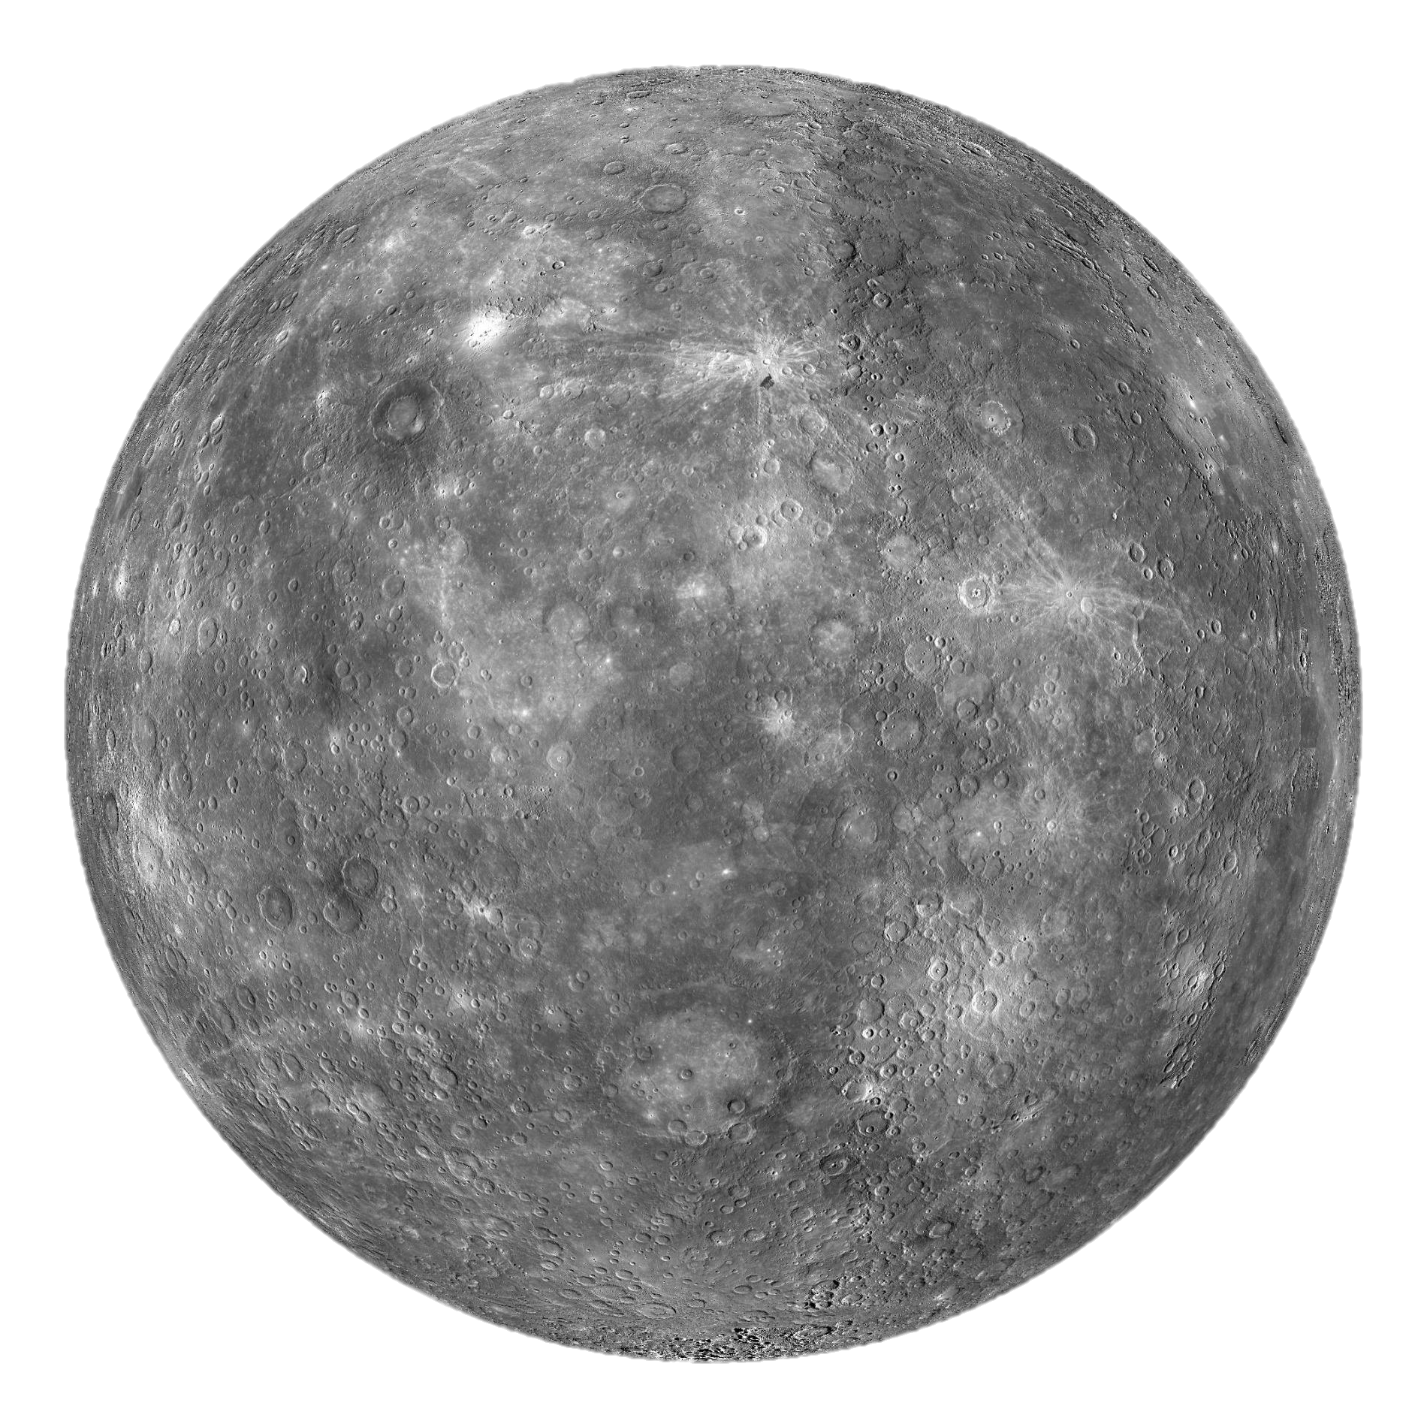
The Orbit of Mercury
Megan Hott

Slide 2
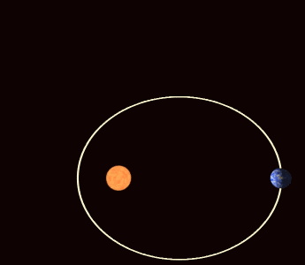

Background
Precession of Mercury’s perihelion
Observed precession: $574.10±0.65”$ per century
Le Verrier calculations
Evidence of General Relativity
Image: https://en.wikipedia.org/wiki/Apsidal_precession

Slide 3
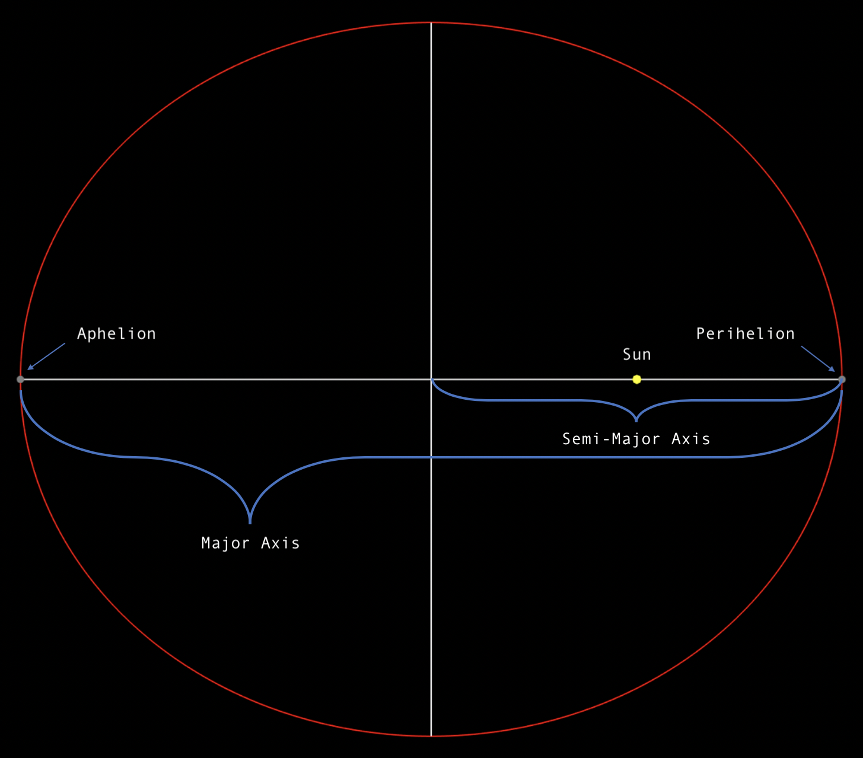

Slide 4
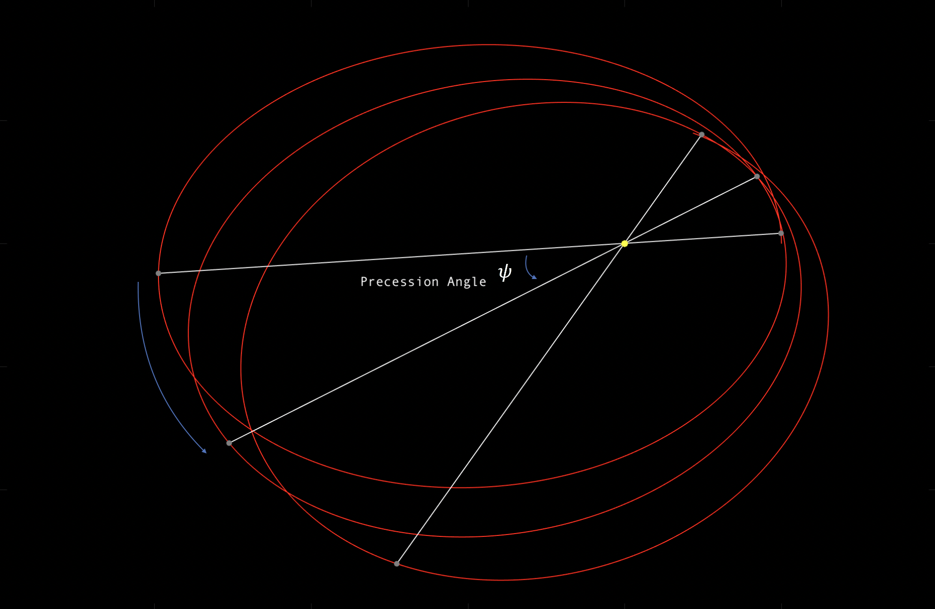

Slide 5
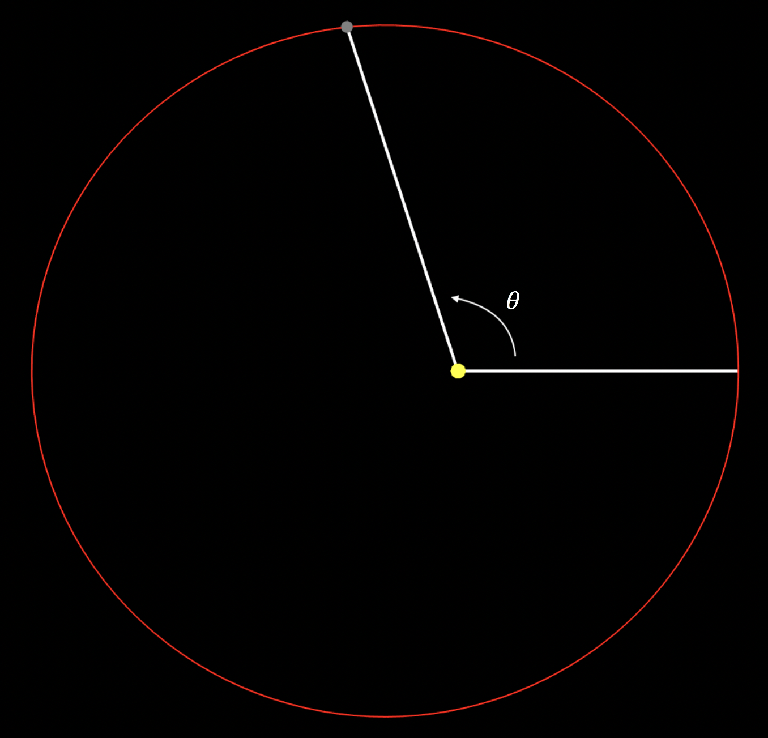

Elliptical Orbits
$$r=\frac{a(1−e^{2})}{1+\cos{θ}}$$
$$x=r\cos{θ}$$
$$y=r\sin{θ}$$
$θ=$ true anomaly

Slide 6

Perturbing force of planets
Planets are approximated as rings: act as a “repulsive gravitational force” centered at the sun
$$F_{sun}=−\frac{GM_{s}m}{r^{2}}$$
$$F_{planet}=\frac{GM_{P}mr}{2R_{P}({R_{P}}^{2}−r^{2})}$$
$$g_{P}\left(r\right)=\frac{F_{planet}}{F_{sun}}=−\frac{M_{P}r^{3}}{2M_{s}R_{P}({R_{P}}^{2}−r^{2})}$$

Slide 7

Outer Planets Correction
Precession for one orbit:
$$ψ=\frac{1}{e}\int_{0}^{2π}{g(r)\cos{θ}dθ}$$
Precession due to one outer planet:
$$ψ=\frac{1}{e}\int_{0}^{2π}{\frac{M_{P}r^{3}}{2M_{s}R_{P}({R_{P}}^{2}−r^{2})}\cos{θ}dθ}=\frac{1}{e}\int_{0}^{2π}{\frac{M_{P}{\left(\frac{a(1−e^{2})}{1+\cos{θ}}\right)}^{3}}{2M_{s}R_{P}\left({R_{P}}^{2}−{\left(\frac{a(1−e^{2})}{1+\cos{θ}}\right)}^{2}\right)}\cos{θ}dθ}$$
Contributes precession of 532.26” per century

Slide 8
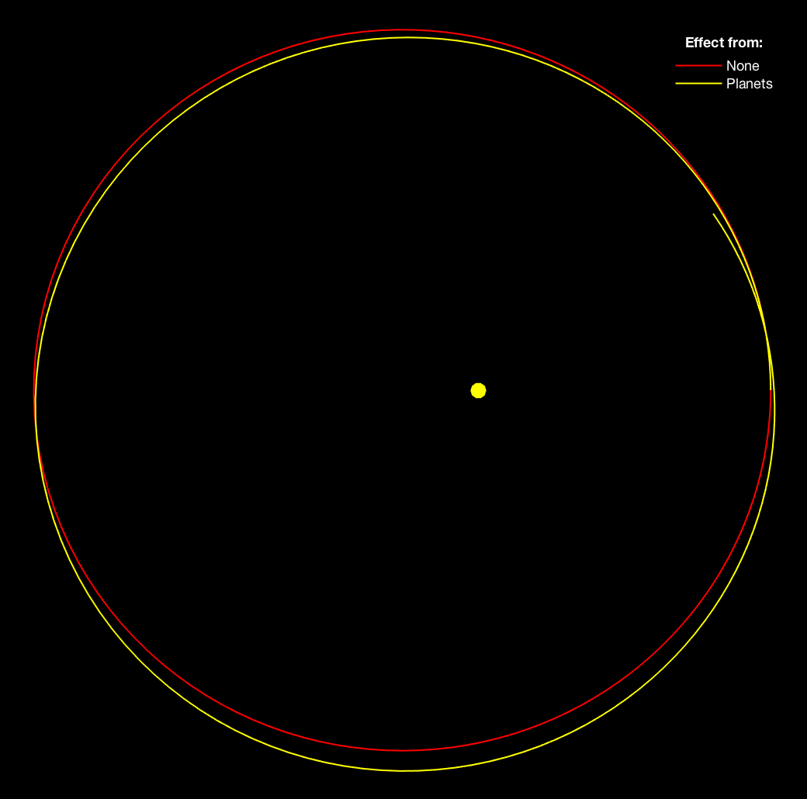

$$x=r\cos{(θ+θψ)}$$
$$y=r\sin{(θ+θψ)}$$
Precession is very exaggerated
($10000×ψ)$

Slide 9

General Relativistic Correction
$$g_{GR}\left(r\right)=\frac{3GM_{s}a(1−e^{2})}{c^{2}r^{2}}$$
$$ψ=\frac{1}{e}\int_{0}^{2π}{\frac{3GM_{s}a(1−e^{2})}{c^{2}r^{2}}\cos{θ}dθ}=\frac{1}{e}\int_{0}^{2π}{\frac{3GM_{s}a(1−e^{2})}{c^{2}{\left(\frac{a(1−e^{2})}{1+\cos{θ}}\right)}^{2}}\cos{θ}dθ}$$
Contributes precession of $42.98”$ per century

Slide 10
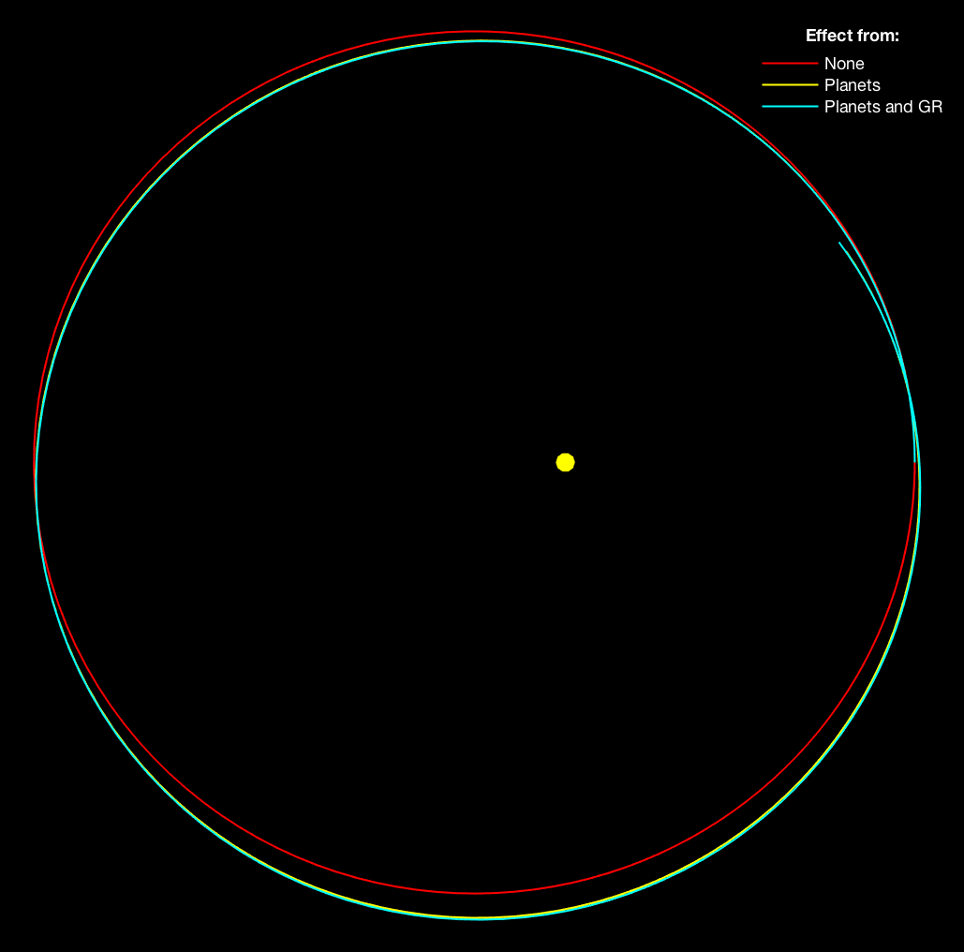

Observed: $574.10±0.65”$
Calculated: $575.25”$
Within 0.2% of observed value

Slide 11
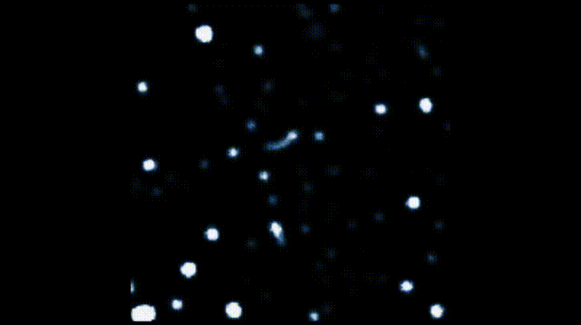
Further Applications
Modeling exoplanets and other star systems
Rosette orbits are often seen around black holes

